Slide 1
Objectives
  Generate simple list reports using the PRINT procedure.
  Display selected variables (columns) in a list report.
  Display selected observations (rows) in a list report.
  Display a list report with column totals.

Slide 2
Overview of PROC PRINT
List reports are typically generated with the PRINT procedure.
The SAS System
Emp Job
Obs ID LastName FirstName Code Salary
1 0031 GOLDENBERG DESIREE PILOT 50221.62
2 0040 WILLIAMS ARLENE M. FLTAT 23666.12
3 0071 PERRY ROBERT A. FLTAT 21957.71
4 0082 MCGWIER-WATTS CHRISTINA PILOT 96387.39
5 0091 SCOTT HARVEY F. FLTAT 32278.40
6 0106 THACKER DAVID S. FLTAT 24161.14
7 0355 BELL THOMAS B. PILOT 59803.16
8 0366 GLENN MARTHA S. PILOT 120202.38

Slide 3
Overview of PROC PRINT
You can display
  titles and footnotes
  descriptive column headings
  formatted data values.
Salary Report
Emp Job Annual
Obs ID LastName FirstName Code Salary
1 0031 GOLDENBERG DESIREE PILOT $50,221.62
2 0040 WILLIAMS ARLENE M. FLTAT $23,666.12
3 0071 PERRY ROBERT A. FLTAT $21,957.71
4 0082 MCGWIER-WATTS CHRISTINA PILOT $96,387.39
5 0091 SCOTT HARVEY F. FLTAT $32,278.40
6 0106 THACKER DAVID S. FLTAT $24,161.14
7 0355 BELL THOMAS B. PILOT $59,803.16
8 0366 GLENN MARTHA S. PILOT $120,202.38

Slide 4
Overview of PROC PRINT
You can display
  column totals
  column subtotals
  page breaks for each subgroup.
The SAS System
------------------------ JobCode=FLTAT -------------------------
Emp
Obs ID LastName FirstName Salary
1 0040 WILLIAMS ARLENE M. 23666.12
2 0071 PERRY ROBERT A. 21957.71
3 0091 SCOTT HARVEY F. 32278.40
4 0106 THACKER DAVID S. 24161.14
------- ---------
JobCode 102063.37

Slide 5
Overview of PROC PRINT
The SAS System
------------------------ JobCode=PILOT -------------------------
Emp
Obs ID LastName FirstName Salary
5 0031 GOLDENBERG DESIREE 50221.62
6 0082 MCGWIER-WATTS CHRISTINA 96387.39
7 0355 BELL THOMAS B. 59803.16
8 0366 GLENN MARTHA S. 120202.38
------- ---------
JobCode 326614.55
=========
428677.92

Slide 6
Creating a Default List Report
General form of the PRINT procedure:
PROC PRINT DATA=SAS-data-set;
RUN;
Example:
libname ia 'SAS-data-library';
proc print data=ia.empdata;
run;
c04s1d1

Slide 7
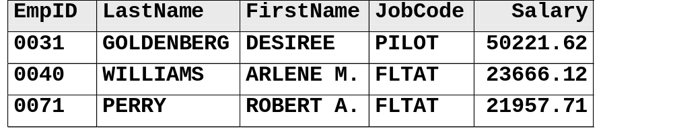
Creating a Default List Report
ia.empdata
PROC Step
libname ia 'SAS-data-library';
proc print data=ia.empdata;
run;
Print all
variables
The SAS System
Emp Job
Obs ID LastName FirstName Code Salary
1 0031 GOLDENBERG DESIREE PILOT 50221.62
2 0040 WILLIAMS ARLENE M. FLTAT 23666.12
3 0071 PERRY ROBERT A. FLTAT 21957.71

Slide 8
Printing Selected Variables
The VAR statement enables you to
  select variables to include in the report
  define the order of the variables in the report.
General form of the VAR statement:
VAR variable(s);

Slide 9
Printing Selected Variables
ia.empdata
PROC Step
Select and order variables to print
proc print data=ia.empdata;
var JobCode EmpID Salary;
run;
The SAS System
Job Emp
Obs Code ID Salary
1 PILOT 0031 50221.62
2 FLTAT 0040 23666.12
3 FLTAT 0071 21957.71
c04s1d2

Slide 10
Suppressing the Obs Column
The NOOBS option suppresses the row numbers on the left side of the report.
General form of the NOOBS option:
PROC PRINT DATA=SAS-data-set NOOBS;
RUN;

Slide 11
Suppressing the Obs Column
ia.empdata
PROC Step
Suppress the Obs column
proc print data=ia.empdata noobs;
var JobCode EmpID Salary;
run;
The SAS System
Job Emp
Code ID Salary
PILOT 0031 50221.62
FLTAT 0040 23666.12
FLTAT 0071 21957.71
c04s1d3

Slide 12
Subsetting Data: WHERE Statement
Produce a listing report that displays information for pilots only.
The WHERE statement
  enables you to select observations that meet a certain condition
  can be used with most SAS procedures.

Slide 13
Subsetting Data: WHERE Statement
General form of the WHERE statement:
where-expression is a sequence of operands and operators.
Operands include
  variables
  constants.
WHERE where-expression;

Slide 14
Subsetting Data: WHERE Statement
Operators include
  comparison operators
  logical operators
  special operators
  functions.

Slide 15
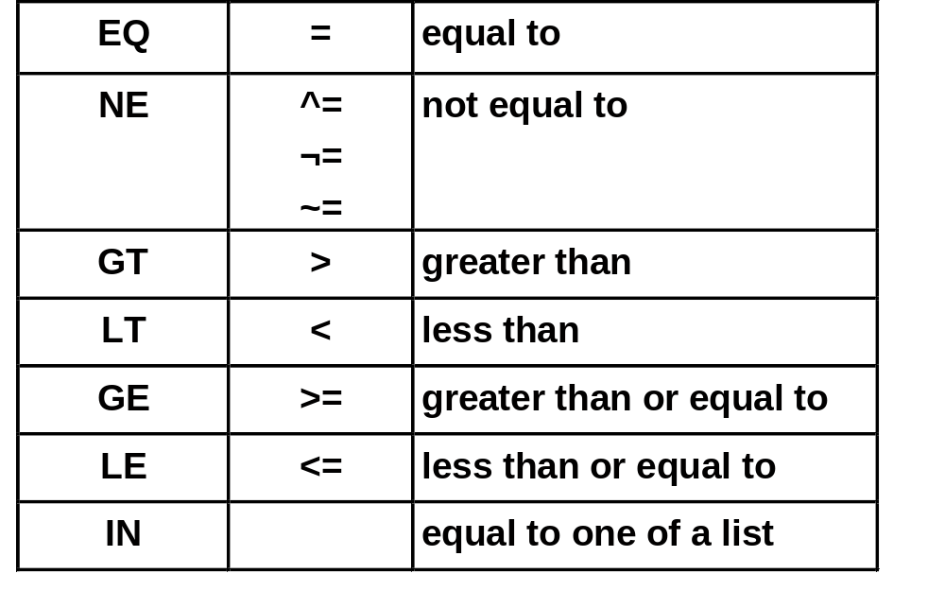
Comparison Operators
Mnemonic Symbol Definition

Slide 16
Comparison Operators
Examples:
where Salary>25000;
where EmpID='0082';
where Salary=.;
where LastName=' ';
where JobCode in('PILOT','FLTAT');
where JobCode in('PILOT' 'FLTAT');
Character comparisons are case-sensitive.
The IN operator allows commas or blanks to separate values.

Slide 17
Logical Operators
Logical operators include
AND if both expressions are true, then the compound expression is true
&
where JobCode='FLTAT' and Salary>50000;
OR if either expression is true, then the compound expression is true
|
where JobCode='PILOT' or JobCode='FLTAT';
NOT can be combined with other operators
to reverse the logic of a comparison.
^
where JobCode not in('PILOT','FLTAT');

Slide 18
Special Operators
Special operators include
BETWEEN-AND selects observations in which the value of the variable falls within a range of values, inclusively.
where Salary between 50000 and 70000;
CONTAINS selects observations that include the specified substring.
?
where LastName ? 'LAM';
(LAMBERT, BELLAMY, and ELAM are selected.)

Slide 19
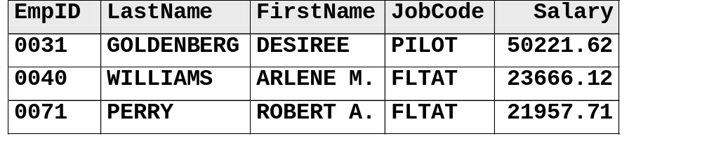
Printing Selected Observations
Use the WHERE statement to control which observations are processed.
ia.empdata
PROC Step
Select
rows to print
proc print data=ia.empdata noobs;
var JobCode EmpID Salary;
where JobCode='PILOT';
run;
The SAS System
Job Emp
Code ID Salary
PILOT 0031 50221.62
PILOT 0082 96387.39
PILOT 0355 59803.16
PILOT 0366 120202.38
c04s1d4

Slide 20
Requesting Column Totals
The SUM statement produces column totals.
General form of the SUM statement:
SUM variable(s);
The SUM statement also produces subtotals if you print the data in groups.

Slide 21
Requesting Column Totals
ia.empdata
PROC Step
Produce
column totals
proc print data=ia.empdata noobs;
var JobCode EmpID Salary;
sum Salary;
run;
The SAS System
Job Emp
Code ID Salary
PILOT 0031 50221.62
FLTAT 0040 23666.12
FLTAT 0071 21957.71
.
.
=========
428677.92
c04s1d5

Slide 22

Exercises
These exercises reinforce the concepts discussed previously.

Slide 23
Section 4.2
Sequencing and Grouping Observations

Slide 24
Objectives
  Sequence (sort) observations in a SAS data set.
  Group observations in a list report.
  Print column subtotals in a list report.
  Control page breaks for subgroups.

Slide 25
Sorting a SAS Data Set
To request subgroup totals in PROC PRINT, the observations in the data set must be grouped.
The SORT procedure
  rearranges the observations in a SAS data set
  can create a new SAS data set containing the rearranged observations
  can sort on multiple variables
  can sort in ascending (default) or descending order
  does not generate printed output
  treats missing values as the smallest possible value.

Slide 26
Sorting a SAS Data Set
General form of the PROC SORT step:
PROC SORT DATA=input-SAS-data-set
<OUT=output-SAS-data-set>;
BY <DESCENDING> by-variable(s);
RUN;
Examples:
proc sort data=ia.empdata;
by Salary;
run;
proc sort data=ia.empdata out=work.jobsal;
by JobCode descending Salary;
run;

Slide 27
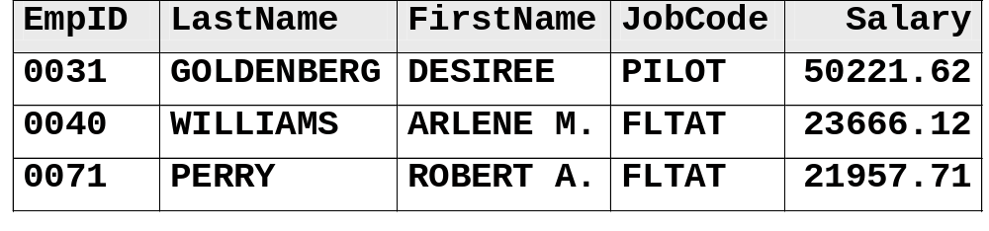
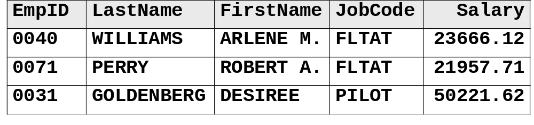
Sorting a SAS Data Set
ia.empdata
PROC
Step
proc sort data=ia.empdata out=work.empdata;
by JobCode;
run;
work.empdata

Slide 28
Printing Subtotals and Grand Totals
Print the data set grouped by JobCode with a subtotal for the Salary column for each JobCode.
proc sort data=ia.empdata out=work.empdata;
by JobCode;
run;
proc print data=work.empdata;
by JobCode;
sum Salary;
run;
Using a BY statement and a SUM statement together in a PROC PRINT step produces subtotals and grand totals.
c04s2d1
...

Slide 29
Printing Subtotals and Grand Totals
The SAS System
------------------------ JobCode=FLTAT -------------------------
Emp
Obs ID LastName FirstName Salary
1 0040 WILLIAMS ARLENE M. 23666.12
2 0071 PERRY ROBERT A. 21957.71
3 0091 SCOTT HARVEY F. 32278.40
4 0106 THACKER DAVID S. 24161.14
------- ---------
JobCode 102063.37
------------------------ JobCode=PILOT -------------------------
Emp
Obs ID LastName FirstName Salary
5 0031 GOLDENBERG DESIREE 50221.62
6 0082 MCGWIER-WATTS CHRISTINA 96387.39
7 0355 BELL THOMAS B. 59803.16
8 0366 GLENN MARTHA S. 120202.38
------- ---------
JobCode 326614.55
=========
428677.92

Slide 30
Page Breaks
Use the PAGEBY statement to put each subgroup on a separate page.
General form of the PAGEBY statement:
PAGEBY by-variable;
proc print data=work.empdata;
by JobCode;
pageby JobCode;
sum Salary;
run;
The PAGEBY statement must be used with a BY statement.
c04s2d2

Slide 31
Page Breaks
First Page
The SAS System 1
------------------------ JobCode=FLTAT -------------------------
Emp
Obs ID LastName FirstName Salary
1 0040 WILLIAMS ARLENE M. 23666.12
2 0071 PERRY ROBERT A. 21957.71
3 0091 SCOTT HARVEY F. 32278.40
4 0106 THACKER DAVID S. 24161.14
------- ---------
JobCode 102063.37

Slide 32
Page Breaks
Second Page
The SAS System 2
------------------------ JobCode=PILOT -------------------------
Emp
Obs ID LastName FirstName Salary
5 0031 GOLDENBERG DESIREE 50221.62
6 0082 MCGWIER-WATTS CHRISTINA 96387.39
7 0355 BELL THOMAS B. 59803.16
8 0366 GLENN MARTHA S. 120202.38
------- ---------
JobCode 326614.55
=========
428677.92

Slide 33
Exercises
These exercises reinforce the concepts discussed previously.

Slide 34
Section 4.3
Identifying Observations (Self-Study)

Slide 35
Objectives
  Use the ID statement to identify observations.
  Combine the BY and ID statements to produce special formatting.

Slide 36
Identifying Observations
The ID statement enables you to
  suppress the Obs column in the report
  specify which variable(s) should replace the Obs column.
General form of the ID statement:
ID variable(s);

Slide 37
Creating a Default List Report
ia.empdata
PROC
Step
Suppress the Obs column
proc print data=ia.empdata;
id JobCode;
var EmpID Salary;
run;
The SAS System
Job Emp
Code ID Salary
PILOT 0031 50221.62
FLTAT 0040 23666.12
FLTAT 0071 21957.71
c04s3d1

Slide 38
Special BY-Group Formatting
When the ID and BY statements specify the same variable,
  the Obs column is suppressed
  the BY line is suppressed
  the ID/BY variable prints in the leftmost column
  each ID/BY value only prints at the start of each BY group (and on the subtotal line, if a SUM statement is used).

Slide 39
Special BY-Group Formatting
Specify JobCode in the BY and ID statements to change the report format.
proc sort data=ia.empdata out=work.empdata;
by JobCode;
run;
proc print data=work.empdata;
by JobCode;
id JobCode;
sum Salary;
run;
c04s3d2

Slide 40
Special BY-Group Formatting
The SAS System
Job Emp
Code ID LastName FirstName Salary
FLTAT 0040 WILLIAMS ARLENE M. 23666.12
0071 PERRY ROBERT A. 21957.71
0091 SCOTT HARVEY F. 32278.40
0106 THACKER DAVID S. 24161.14
----- ---------
FLTAT 102063.37
PILOT 0031 GOLDENBERG DESIREE 50221.62
0082 MCGWIER-WATTS CHRISTINA 96387.39
0355 BELL THOMAS B. 59803.16
0366 GLENN MARTHA S. 120202.38
----- ---------
PILOT 326614.55
=========
428677.92

Slide 41
Exercises
These exercises reinforce the concepts discussed previously.

Slide 42
Section 4.4
Special WHERE Statement Operators (Self-Study)

Slide 43
Objectives
  Use special operators in the WHERE statement to subset data.

Slide 44
Special Operators
Additional special operators supported by the WHERE statement are
  LIKE
  sounds like
  IS MISSING (or IS NULL).

Slide 45
Special Operators
The following are special operators :
  LIKE selects observations by comparing character values to specified patterns.
  A percent sign (%) replaces any number of characters.
  An underscore (_) replaces one character.
where Code like 'E_U%';
  Selects observations where the value of Code begins with an E, followed by a single character, followed by a U, followed by any number of characters.

Slide 46
Special Operators
  The sounds like (=*) operator selects observations that contain spelling variations of the word or words specified.
  Selects names like SMYTHE and SMITT.
  IS NULL or IS MISSING selects observations in which the value of the variable is missing.
where Name=*'SMITH';
where Flight is missing;
where Flight is null;

Slide 47
Exercises
These exercises reinforce the concepts discussed previously.

